Slide 1
Communication -2
Department of Humanities & Social Sciences
JIIT, Noida

Slide 2
Topics to be covered:
Levels of Communication
Flow of Communication
Communication Networks
Barriers to Communication
Methods to overcome Barriers
Resources to be consulted for further reading:
Chaturvedi. P.D ( 2011). Business Communication: Concepts, Cases, and
Applications, Second edition, Pearson Education India.
Its online availability site:
https://docs.google.com/viewer?a=v&pid=sites&srcid=ZGVmYXVsdGRvbWFpbnxvbG
Vya2RyZXN8Z3g6MjU4MTc4NTNmMTdjMWVjNg
Rizvi, A. R. ( 2018) ‘Effective Technical Communication’ 2nd edition, McGraw Hill
Education Private Limited, Chennai.

Slide 3
Levels of Communication
Extra-personal Communication
Intrapersonal Communication
Interpersonal Communication
Organizational Communication
Mass & Media Communication

Slide 4
Flow of Communication in an Organization
Organizational Channels
Formal
Vertical
(Upward & Downward)
Horizontal/Lateral
Informal
Grapevine
Diagonal

Slide 5
Communication Network
A communication Network is a collection of means and methods that senders and receivers employ to share a message.
Networks are used in both formal and informal communication.

Slide 6
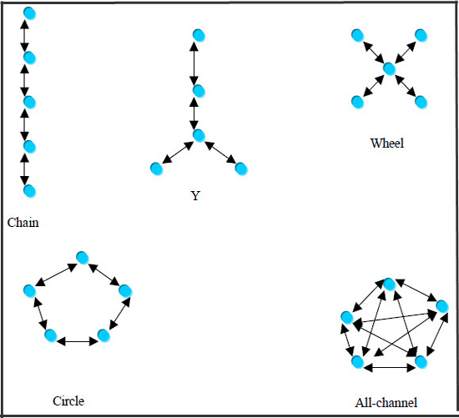
Communication Networks: Formal

Slide 7
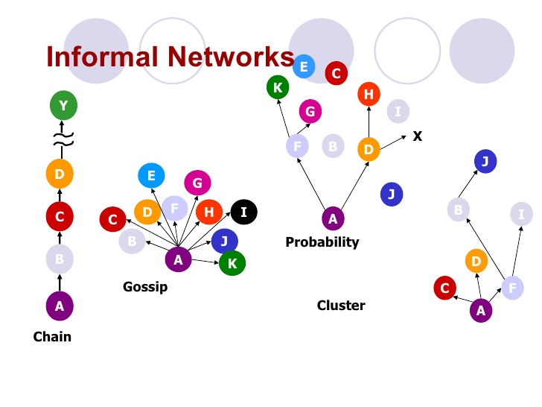
Communication Networks: Informal

Slide 8
Exercise: For the following tasks, identify the necessary direction of communication which is best suited:
You want to inform your juniors about a debate competition
You want to convince your teacher of the need for an extra class
You want the whole batch to bunk a class without actually telling them it’s a mass bunk
You want to announce a class outing to the nearby water-park to your batchmates

Slide 9
While walking through the college pathway one cold dark evening, just about 2 days before your Chemistry exam, you suddenly overhear two boys discussing the Chemistry paper. On eavesdropping, you realize that the chemistry paper has been leaked and those two boys have it with them. You suddenly feel a chill run down your spine and your stomach turns queasy. You want to discuss this grave issue with someone.
Who will you communicate the message to in the following four cases:
Horizontal communication
Formal Chain Communication Network
Grapevine
Vertical Communication

Slide 10
Barriers in the process of Communication
Improper encoding
Semantic Gap
Noise
Poor listening
Bypassing
Frame of reference
Physical distractions
Psychological and emotional interference
Cultural differences

Slide 11
Organizational Barriers
Information overload
Innumerable channels
Too many transfer stations
Wrong choice of medium

Slide 12
Overcoming Communication Barriers
Positive Attitude
Realize that communication is imperfect.
Adapt the message to the receiver.
Improve your language and listening skills.
Question your preconceptions.
Plan for feedback.

Slide 13
A Classic Case of Miscommunication
In Center Harbor, Maine, local legend recalls the day some 10 years ago when Walter Cronkite steered his boat into port. The avid sailor, as it's told, was amused to see in the distance a small crowd of people on shore waving their arms to greet him. He could barely make out their excited shouts of "Hello Walter ... Hello Walter."

Slide 14
As his boat sailed closer, the crowd grew larger, still yelling "Hello Walter ... Hello Walter." Pleased at the reception, Cronkite tipped his white captain's hat, waved back, even took a bow.
But before reaching dockside, Cronkite's boat abruptly jammed aground. The crowd stood silent. The veteran news anchor suddenly realized what they'd been shouting: "Low water ... low water."

Slide 15
Analysis of Flawed Communication Process
Sender has idea
Warn boater
Sender encodes message
“Low water!”
Channel carries message
Message distorted
Receiver decodes message
“Hello Walter!”
Notes:
15
20

Slide 16
Barriers That Caused Cronkite Miscommunication
Frame of reference
Language skills
Listening skills
Receiver accustomed to acclaim and appreciative crowds.
Maine accent makes "water" and "Walter" sound similar.
Receiver more accustomed to speaking than to listening.
Notes:
16

Slide 17
Barriers That Caused Cronkite Miscommunication
Emotional interference
Physical barriers
Ego prompted receiver to believe crowd was responding to his celebrity status.
Noise from boat, distance between senders and receivers.
Which of these barriers could be overcome through improved communication skills?
Notes:
17

Slide 18
Learning & Relevance
Effective communication requires effort.
Effective communication requires empathy.
Recognizing and overcoming barriers is key to effective communication.
Remember: Communication is a skill….and with determination and hard work, you can master this skill!!
A prerequisite in the global workforce.

Slide 19
Let’s Revise!!
Grapevine is always negative in nature. T/F
Barriers take place only because of the receiver. T/F
When one person talks to another person, it is called __________communication.
Which of these should not be avoided for effective communication?
a) noise b) cultural differences c) positive attitude
Discuss the various barriers in the process of communication with appropriate examples.

Slide 20
References
https://www.wisdomjobs.com/e-university/principles-of-management-and-organisational-behaviour-tutorial-366/communication-networks-12761.html
https://www.slideshare.net/abshar2525/informal-communication-grapevine
https://www.coursehero.com/file/p4qecmd/Realize-that-communication-is-imperfect-Adapt-message-to-the-receiver-Improve/
https://www.washingtonpost.com/archive/lifestyle/1987/02/27/in-one-earwhat-you-hear-isnt-always-what-you-get/40625511-d8d1-4923-86ab-3f67aa0aed2e/
https://www.coursehero.com/file/p25i83/Mary-Ellen-Guffey-Business-Communication-Process-and-Product-5e-Ch-1-Analysis/
Mishra, B. & Sharma, S.(2010) Communication Skills for Engineers and Scientists. First edition, PHI Learning Ltd.
Chaturvedi. P.D ( 2011). Business Communication: Concepts, Cases, and Applications, Second edition, Pearson Education India.
Rizvi, A. R. ( 2018) ‘Effective Technical Communication’ 2nd edition, McGraw Hill Education Private Limited, Chennai.

